Slide 1
Artificial Intelligence IT-511
Modified slides of S. Russell and P. Norvig (http://aima.cs.berkeley.edu)

Slide 2
LECTURE 2
Intelligent Agents
Reading: Chapter 2

Slide 3
Outline
Agents and Environments
Rationality
PEAS (Performance Measure, Environment, Actuators, Sensors)
Environment Types
Agent types

Slide 4
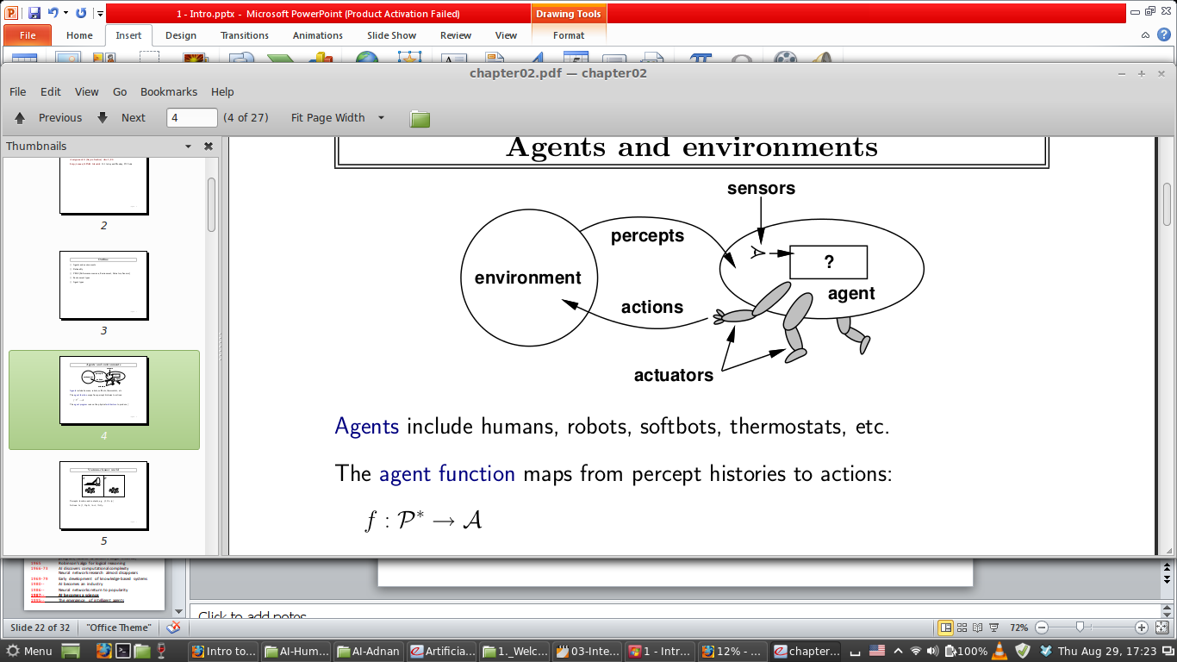
Intelligent Agents
An agent is an entity that perceives and acts
Agent includes human, robot, softbot, thermostat, etc.
Abstractly, an agent is a function from percept histories to actions: f : P* -> A
The agent program runs on the physical architecture to produce f
Agent = architecture + program
Perception Action Cycle

Slide 5
Intelligent Agents Cont.
For any given class of environments and tasks, we seek the agent with the optimal (best) performance
Caveat: computational limitations make perfect rationality unachievable
Attempt to design the most intelligent program, under the given resources.

Slide 6
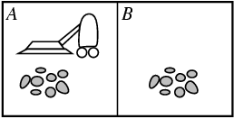
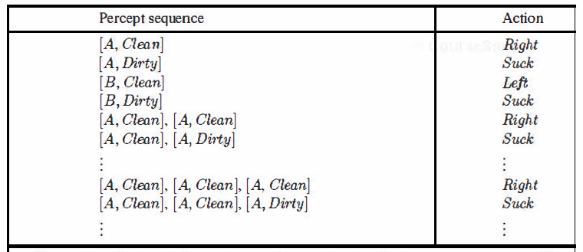
Vacuum-cleaner world
Percepts: location and contents, e.g., [A, Dirty]
Actions: Left, Right, Suck, NoOp

Slide 7
Rationality – Performance Measure
An agent should strive to "do the right thing", based on what it can perceive(understand) and the actions it can perform
The right action is the one that will cause the agent to be most successful
Performance measure: An objective criterion for success of an agent's behavior
Example: Performance measure of a vacuum-cleaner agent could be:
Amount of dirt cleaned up
Amount of time taken
Amount of electricity consumed
Amount of noise generated, etc.

Slide 8
Rational Agent - Role
Rational Agent: For each possible percept sequence, a rational agent should select an action that is expected to maximize its performance measure
We can also use the term “optimizing the performance measure”.

Slide 9
Rational Agent – 3 Traits(drawbacks_
Rational ≠ omniscient(know everything_
command may not supply all relevant information
Rational ≠ clairvoyant (literally “clear vision”)
Action outcomes may not be as expected
Hence, rational ≠ successful
Rational => exploration, learning, autonomy
Notes:
Omniscient: knows everything autonomy: Independent

Slide 10
PEAS Performance measure, Environment, Actuators, Sensors
Must specify the setting for intelligent agent design
Ex: The task of designing a driverless taxi:
Performance measure:
Safe, fast, legal, comfortable trip, maximize profits
Environment:
Roads, other traffic, pedestrians, customers
Actuators:
Steering wheel, accelerator, brake, signal, horn
Sensors:
Cameras, speedometer, GPS, engine sensors

Slide 11

PEAS
Agent: Medical Diagnosis System
Performance measure:
Healthy patient, minimize costs, lawsuits
Environment:
Patient, hospital, staff
Actuators:
Screen display (questions, tests, diagnoses, treatments, referrals)
Sensors:
Keyboard (entry of symptoms, findings, patient's answers)

Slide 12
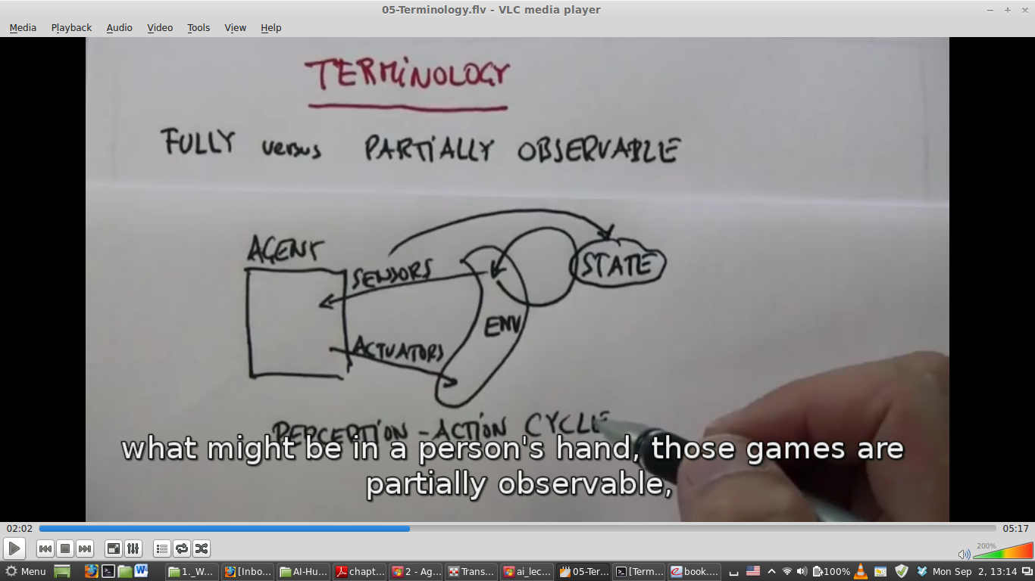
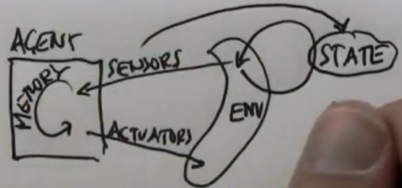
Environment types
Fully observable (vs. partially observable):
An agent can sense at any point in time is completely sufficient to make the optimal decision.
An agent's sensors give it access to the complete state of the environment at each point in time.
Cards games when all cards are displayed vs. poker

Slide 13
Environment types Cont.
Single Agent (vs. Multi-Agent):
An agent operating by itself in an environment
In the multi-agent case, the performance measure of one agent depends on the performance measures of the other agent(s)
Competitive multi-agent: Chess Playing
Collaborative multi-agent: Robo Soccer

Slide 14
Environment types Cont.
Deterministic (vs. stochastic):
The next state of the environment is completely determined by the current state and the action executed by the agent.
Chess vs. rolling a dice
Static (vs. Dynamic):
The environment is unchanged while an agent is deliberating which action to execute
The environment is semi-dynamic if the environment itself does not change with the passage of time but the agent's performance score does, e.g., checkers

Slide 15
Environment types Cont.
Episodic (vs. sequential):
The agent's experience is divided into atomic "episodes" (each episode consists of the agent perceiving and then performing a single action), and the choice of action in each episode depends only on the episode itself.
Classification tasks vs. chess and taxi driving
Discrete (vs. Continuous):
The environment is discrete if the number of actions and possible states of the environment is finite otherwise it is continuous
Chess vs. throwing darts

Slide 16
Environment types Cont.
Benign (vs. Adversarial)
The environment might be random and/or stochastic but it has no objective on its own that would contradict the own objective
Weather vs. chess
Notes:
Benign: gentle
Adversarial: involving opposition

Slide 17
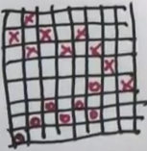
Quiz: Checkers Environment
Fully observable / Partial?
Fully Observable
Single Agent/ Multi Agent
Multi
Deterministic / Stochastic
Deterministic
Episodic / Sequential
Sequential
Discrete / Continuous
Discrete
Static / Dynamic
Semi
Benign / Adversarial
Adversarial

Slide 18
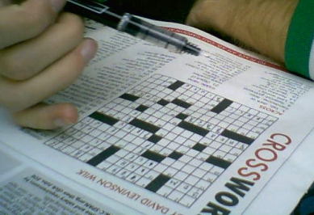
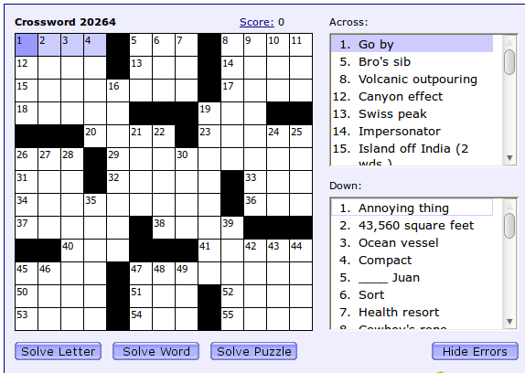
Quiz: Crossword Puzzles
Fully observable / Partial?
Fully Observable
Single Agent/ Multi Agent
Multi
Deterministic / Stochastic
Deterministic
Episodic / Sequential
Sequential
Discrete / Continuous
Discrete
Static / Dynamic
Semi
Benign / Adversarial
Adversarial

Slide 19
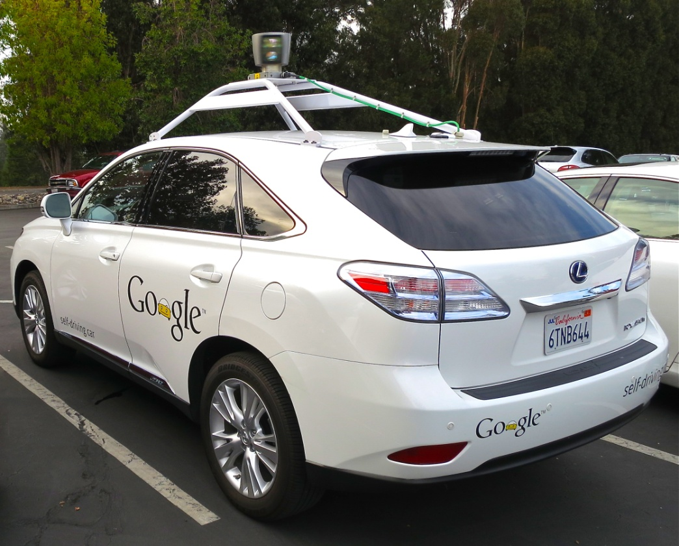
Quiz: Driverless car
Fully observable / Partial?
Partially Observable
Single Agent/ Multi Agent
Multi
Deterministic / Stochastic
Stochastic
Episodic / Sequential
Sequential
Discrete / Continuous
Continuous
Static / Dynamic
Dynamic
Benign / Adversarial
Benign

Slide 20

Quiz: Medical diagnosis
Fully observable / Partial?
Partially Observable
Single Agent/ Multi Agent
Single
Deterministic / Stochastic
Stochastic
Episodic / Sequential
Sequential
Discrete / Continuous
Continuous
Static / Dynamic
Dynamic
Benign / Adversarial
Benign

Slide 21
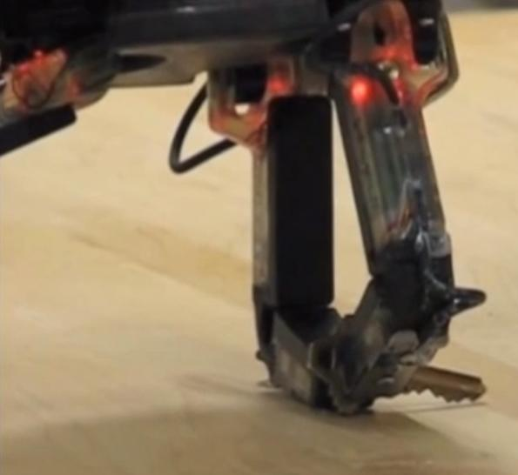
Quiz: Part-Picking Robot
Fully observable / Partial?
Partially Observable
Single Agent/ Multi Agent
Single
Deterministic / Stochastic
Stochastic
Episodic / Sequential
Episodic
Discrete / Continuous
Continuous
Static / Dynamic
Dynamic
Benign / Adversarial
Benign

Slide 22
The real world
The real world is (of course)
Partially observable
Stochastic
Sequential
Dynamic
Continuous
Multi-agent

Slide 23
AI and Uncertainty
AI as uncertainty management
AI = What to do when you don’t know what to do
Reasons of Uncertainty:
Sensor limits
Adversaries
Stochastic environments: throwing a dice
Laziness: your program is lazy
Ignorance
AI is the discipline that deals with uncertainty and manages it in decision making.

Slide 24
Agent Functions and Programs
An agent is completely specified by the agent function that maps percept sequences to actions: : f : P* -> A
Can also be labeled as the strategy of the agent
There could be many possible agent functions
Aim: Discover the most rational (optimal) agent function

Slide 25
Table-lookup Agent
Simplest possible agent function:
All possible states and their optimal actions specified by the designers in advance
Drawbacks:
Huge table (consider continuous states)
Could take a long time to build the table
No autonomy!
Even with learning, agent could need a long time to learn the table entries.

Slide 26
Agent types
Four basic types in order of increasing generality:
Simple Reflex agents
Model-based Reflex agents
Goal-based agents
Utility-based agents
And Finally: Learning agents

Slide 27
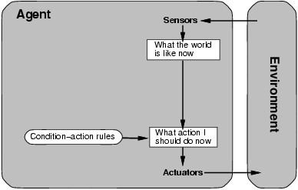
Simple Reflex Agents
Applies condition-action rules based only on the current input (reflex)

Slide 28
Simple Reflex agents
Automated Taxi:
Agent observes rain falling on the windshield: Agent powers on the viper
Agent observes a red signal; Agent applies breaks until the taxi stops.
if signal-in-front-is-red then initiate-braking.

Slide 29
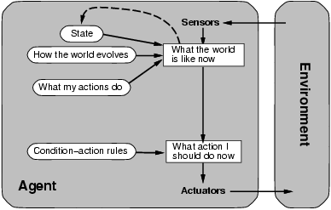
Model-based Reflex agents
Handles Partial Observability by creating a model

Slide 30
Model-based Reflex agents
It works by finding a rule whose condition matches the current state (as defined by percept and stored internal state) and then doing the action associated with that rule.

Slide 31
Model-based Reflex agents
Robo-Soccer Example:
Imagine a robotic goalkeeper
It can build a model of the dynamics of the game that is played on the field, e.g., when the ball is kicked in its direction, the ball will be nearer to it in the next time step
If this robot is not able to acquire its state at some time step, then using the model, it knows that the ball has come nearer
It also knows what consequences a dive will have
So, it can time its dive early and hence, save the goal.

Slide 32
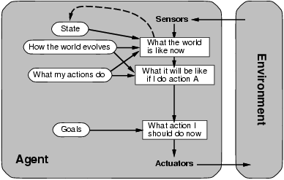
Goal-based agents
Along with the model, you need goals to direct the agent function.

Slide 33
Goal-based Agents
Automated Taxi:
Consider the agent at a crossing, where it can turn right, left, or go straight
Using the model, the Agent can understand the consequences of turning left, right or going straight ahead
All 3 might seem the optimal actions to take
However, the agent needs to select one of these actions in order to reach the destination of the passenger.

Slide 34
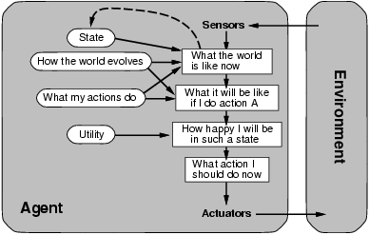
Utility-based agents
Solves the problem of conflicting goals, and quantifies the acquirement of goal

Slide 35
Utility-based Agent
Automated Taxi:
Consider the agent at a crossing, where it can turn right, left, or go straight
What to do when all three goes to the destination?
The agent will calculate the utility of each such action
It will select the action which maximizes the utility function, i.e., in most cases, the expected profit that the agent can expect to receive in the long run (when the passenger reaches the destination)

Slide 36
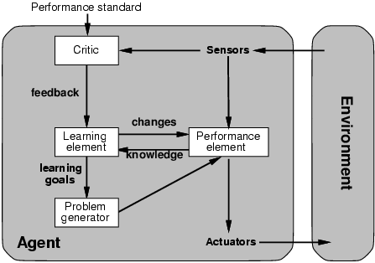
Learning Agents
Feedback
Agent
Function
Agent
Program
Random Action Selector

Slide 37
Learning Agents
Automated Taxi:
Performance element: Consists of whatever collection of knowledge and procedures the taxi has for selecting its driving actions. The taxi drives using this performance element.
Critic: observes the world and passes information along to the learning element.
Ex: taxi makes a quick left turn across three lanes of traffic
The critic observes the shocking language used by other drivers
Learning element learns from this experience and makes a rule identifying it as a bad action, modifying performance element
Problem generator might identify certain areas of behavior in need of improvement and suggest experiments
Ex: trying out the brakes on different road surfaces under different conditions

Slide 38
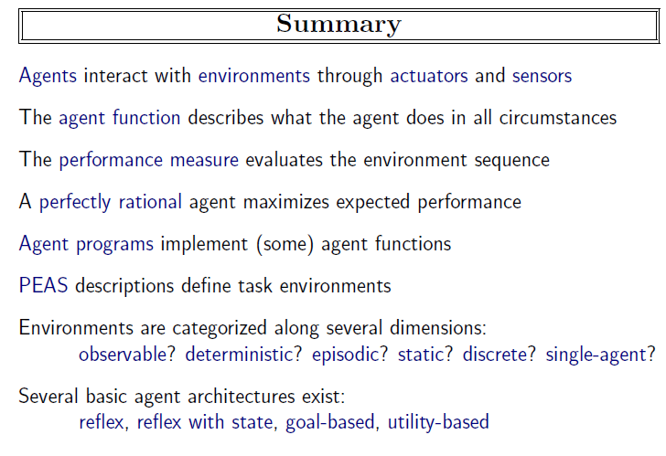

Slide 39

Questions

